Slide 1
Kombinasi Teknik Resampling dan Algoritma Machine Learning Pada Kelas tak Seimbang
Zinedine Kahlil Gibran Zidane
H13116304

Slide 2
Image Segmentation
Spambase
Data Cleaning
Normalisasi
PCA
Dataset Rebalancing
5-Fold CV
Resample
3-Fold CV
Testing
Hasil
Credit Card Fraud

Slide 3
Image Segmentation
Image Segmentation Dataset
Image Segmentation
short-line-density-2
0
0
0
0
…
0
short-line-density-5
0
0
0
0
…
0
region_pixel_count
9
9
9
9
…
9
… | X20
… | …
… | …
… | …
… | …
… | …
… | …
Imbalanced Ratio
1 : 6
Spambase
Data Cleaning
Normalisasi
PCA
Dataset Rebalancing
5-Fold CV
Resample
3-Fold CV
Testing
Hasil
Attributes
20
Observations
2308
Credit Card Fraud

Slide 4
Image Segmentation
Image Segmentation
short-line-density-2
0
0
0
0
…
0
short-line-density-5
0
0
0
0
…
0
region_pixel_count
9
9
9
9
…
9
… | X20
… | …
… | …
… | …
… | …
… | …
… | …
Imbalanced Ratio
1 : 6
Spambase
Data Cleaning
Normalisasi
PCA
Dataset Rebalancing
5-Fold CV
Resample
3-Fold CV
Testing
Hasil
Attributes
20
Observations
2308
Credit Card Fraud

Slide 5
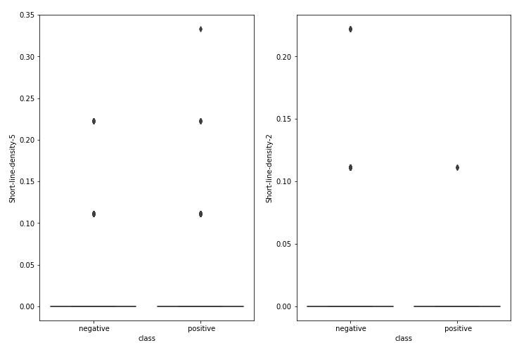
Image Segmentation
short-line-density-5
short-line-density-2
Image Segmentation
short-line-density-2
0
0
0
0
…
0
short-line-density-5
0
0
0
0
…
0
Imbalanced Ratio
1 : 6
Spambase
Data Cleaning
Normalisasi
PCA
Dataset Rebalancing
5-Fold CV
Resample
3-Fold CV
Testing
Hasil
Attributes
20
Observations
2308
Credit Card Fraud

Slide 6
Image Segmentation
Image Segmentation
region-centroid-row
0
1
2
3
…
255
region-centroid-col
0
1
2
3
…
255
Imbalanced Ratio
1 : 6
Spambase
Data Cleaning
Normalisasi
PCA
Dataset Rebalancing
5-Fold CV
Resample
3-Fold CV
Testing
Hasil
Attributes
20
Observations
2308
Credit Card Fraud

Slide 7
Image Segmentation
Image Segmentation
Imbalanced Ratio
1 : 6
Spambase
Data Cleaning
Normalisasi
PCA
Dataset Rebalancing
5-Fold CV
Resample
3-Fold CV
Testing
Hasil
Attributes
15
Observations
2308
Credit Card Fraud

Slide 8
Image Segmentation
Image Segmentation
Spambase
Data Cleaning
Normalisasi
PCA
Dataset Rebalancing
5-Fold CV
Resample
3-Fold CV
Testing
Hasil
Credit Card Fraud

Slide 9
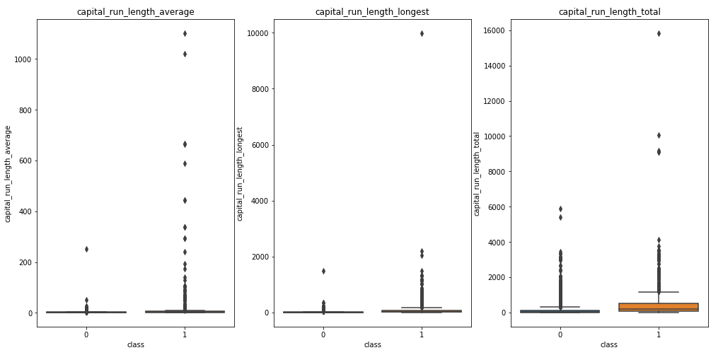
Spambase
Image Segmentation
Image Segmentation
Spambase Dataset
Imbalanced Ratio
2 : 3
Data Cleaning
Normalisasi
PCA
Dataset Rebalancing
5-Fold CV
Resample
3-Fold CV
Testing
Hasil
Attributes
58
Observations
4601
4000
200
1400
Credit Card Fraud

Slide 10
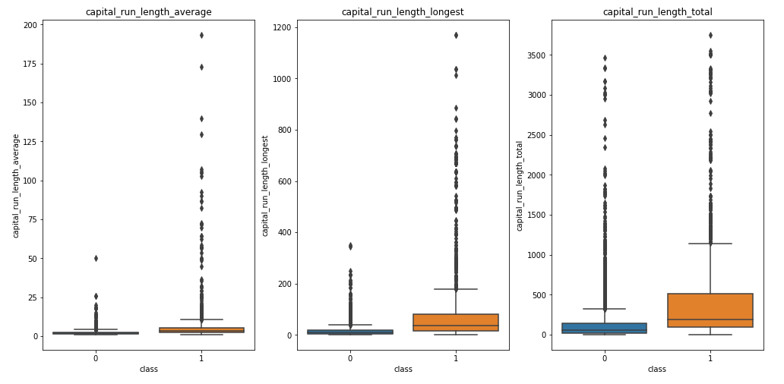
Spambase
Image Segmentation
Image Segmentation
Spambase Dataset
Imbalanced Ratio
2 : 3
Data Cleaning
Normalisasi
PCA
Dataset Rebalancing
5-Fold CV
Resample
3-Fold CV
Testing
Hasil
Attributes
58
Observations
4601
Credit Card Fraud

Slide 11
Spambase
Image Segmentation
Image Segmentation
Spambase Dataset
Imbalanced Ratio
2 : 3
Data Cleaning
Normalisasi
PCA
Dataset Rebalancing
5-Fold CV
Resample
3-Fold CV
Testing
Hasil
Attributes
58
Observations
4580
Credit Card Fraud

Slide 12
Image Segmentation
Image Segmentation
Spambase
Spambase
Data Cleaning
Normalisasi
PCA
Dataset Rebalancing
5-Fold CV
Resample
3-Fold CV
Testing
Hasil
Credit Card Fraud
Credit Card Fraud

Slide 13
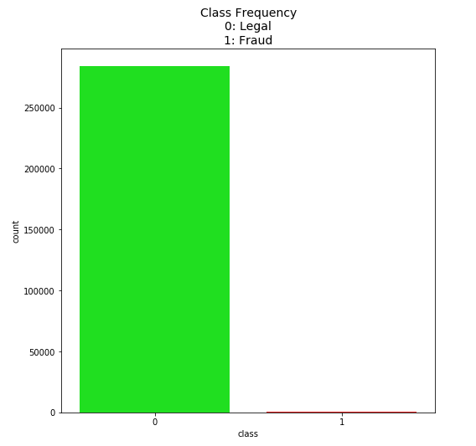
Credit Card Fraud
Image Segmentation
Image Segmentation
Credit Card Fraud Dataset
Imbalanced Ratio
Spambase
Spambase
1 : 577
Data Cleaning
Normalisasi
PCA
Dataset Rebalancing
5-Fold CV
Resample
3-Fold CV
Testing
Hasil
Attributes
30
Observations
284807

Slide 14
Credit Card Fraud
 | Time | V1 | V2 | … | V27 | V28 | Amount
count | 284807.00000 | 2.848070e+05 | 2.848070e+05 | … | 2.848070e+05 | 2.848070e+05 | 284807.00000
mean | 94813.859575 | 1.758743e-12 | -8.252298e-13 | … | 3.332112e-12 | -3.518886e-12 | 88.349619
std | 47488.145955 | 1.958696e+00 | 1.651309e+00 | … | 4.036325e-01 | 3.300833e-01 | 250.120109
min | 0.000000 | -5.640751e+01 | -7.271573e+01 | … | -2.256568e+01 | -1.543008e+01 | 0.000000
25% | 54201.500000 | -9.203734e-01 | -5.985499e-01 | … | -7.083953e-02 | -5.295979e-02 | 5.600000
50% | 84692.000000 | 1.810880e-02 | 6.548556e-02 | … | 1.342146e-03 | 1.124383e-02 | 22.000000
75% | 139320.50000 | 1.315642e+00 | 8.037239e-01 | … | 9.104512e-02 | 7.827995e-02 | 77.165000
max | 172792.00000 | 2.454930e+00 | 2.205773e+01 | … | 3.161220e+01 | 3.384781e+01 | 25691.160000
Image Segmentation
Time
284807.00000
94813.859575
47488.145955
0.000000
54201.500000
84692.000000
139320.50000
172792.00000
Image Segmentation
Amount
284807.00000
88.349619
250.120109
0.000000
5.600000
22.000000
77.165000
25691.160000
Credit Card Fraud Dataset
Imbalanced Ratio
Spambase
Spambase
1 : 577
Data Cleaning
Normalisasi
PCA
Dataset Rebalancing
5-Fold CV
Resample
3-Fold CV
Testing
Hasil
Attributes
30
Observations
284807
Sebaran data di sekitar 0

Slide 15
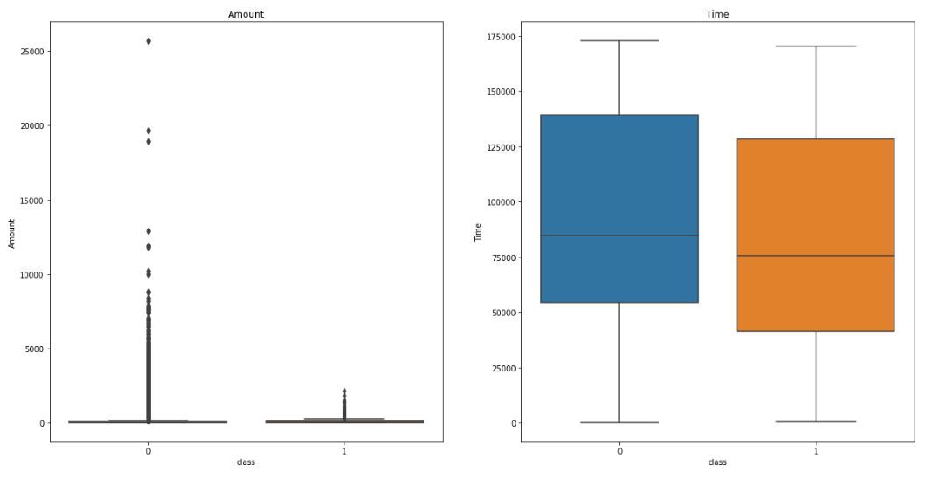
Credit Card Fraud
Image Segmentation
Image Segmentation
Time
284807.00000
94813.859575
47488.145955
0.000000
54201.500000
84692.000000
139320.50000
172792.00000
Amount
284807.00000
88.349619
250.120109
0.000000
5.600000
22.000000
77.165000
25691.160000
Credit Card Fraud Dataset
Imbalanced Ratio
Spambase
Spambase
1 : 577
Data Cleaning
Normalisasi
PCA
Dataset Rebalancing
5-Fold CV
Resample
3-Fold CV
Testing
Hasil
Attributes
30
Observations
284807
4000

Slide 16
df = removeOutlier(df, 'Amount', 5000)
df = removeOutlier(df, 'V3', 5)
df = removeOutlier(df, 'V3', -30, False)
df = removeOutlier(df, 'V5', -40, False)
df = removeOutlier(df, 'V6', 30)
df = removeOutlier(df, 'V7', 50)
df = removeOutlier(df, 'V8', -45, False)
df = removeOutlier(df, 'V9', 10)
df = removeOutlier(df, 'V10', 20)
df = removeOutlier(df, 'V12', 5)
df = removeOutlier(df, 'V13', 5)
df = removeOutlier(df, 'V13', -5, False)
df = removeOutlier(df, 'V15', 7)
df = removeOutlier(df, 'V15', -4, False)
df = removeOutlier(df, 'V16', 10)
df = removeOutlier(df, 'V19', -5, False)
df = removeOutlier(df, 'V20', -40, False)
df = removeOutlier(df, 'V20', 30)
df = removeOutlier(df, 'V21', 25)
df = removeOutlier(df, 'V21', -30, False)
df = removeOutlier(df, 'V22', -7.5, False)
df = removeOutlier(df, 'V22', 7.5)
df = removeOutlier(df, 'V25', -8, False)
df = removeOutlier(df, 'V27', 15)
df = removeOutlier(df, 'V27', -15, False)
df = removeOutlier(df, 'V28', 15)
df = removeOutlier(df, 'V28', -11, False)
Credit Card Fraud
Image Segmentation
Image Segmentation
Credit Card Fraud Dataset
Imbalanced Ratio
Spambase
Spambase
1 : 577
Data Cleaning
Normalisasi
PCA
Dataset Rebalancing
5-Fold CV
Resample
3-Fold CV
Testing
Hasil
Attributes
30
Observations
284807

Slide 17
Credit Card Fraud
Image Segmentation
Image Segmentation
Credit Card Fraud Dataset
Imbalanced Ratio
Spambase
Spambase
1 : 577
Data Cleaning
Normalisasi
PCA
Dataset Rebalancing
5-Fold CV
Resample
3-Fold CV
Testing
Hasil
Attributes
30
Observations
284689
-118
Credit Card Fraud

Slide 18
Image Segmentation
Image Segmentation
Spambase
Spambase
Data Cleaning
Normalisasi
PCA
Dataset Rebalancing
5-Fold CV
Resample
3-Fold CV
Testing
Hasil
Credit Card Fraud
Credit Card Fraud

Slide 19
Image Segmentation
Image Segmentation
Image Segmentation
Spambase
Spambase
Spambase
Data Cleaning
Normalisasi
PCA
Dataset Rebalancing
5-Fold CV
Resample
3-Fold CV
Testing
Hasil
Log Transform (Left Skewed)
MinMax
Credit Card Fraud
Credit Card Fraud
Credit Card Fraud
Standard Transform
Shapiro-Wilk Test

Slide 20
Image Segmentation
Image Segmentation
Image Segmentation
Spambase
Spambase
Spambase
Data Cleaning
Normalisasi
PCA
Dataset Rebalancing
5-Fold CV
Resample
3-Fold CV
Testing
Hasil
Credit Card Fraud
Credit Card Fraud
Credit Card Fraud

Slide 21
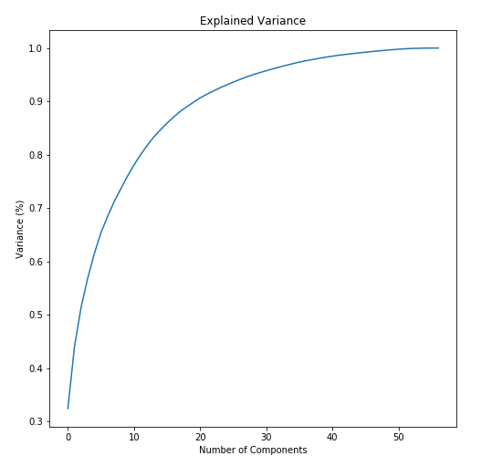
PCA
Spambase
Image Segmentation
Image Segmentation
19 komponen
Spambase
Spambase
Spambase
Data Cleaning
Normalisasi
Dataset Rebalancing
5-Fold CV
Resample
3-Fold CV
Testing
Hasil
Credit Card Fraud
Credit Card Fraud
Credit Card Fraud

Slide 22
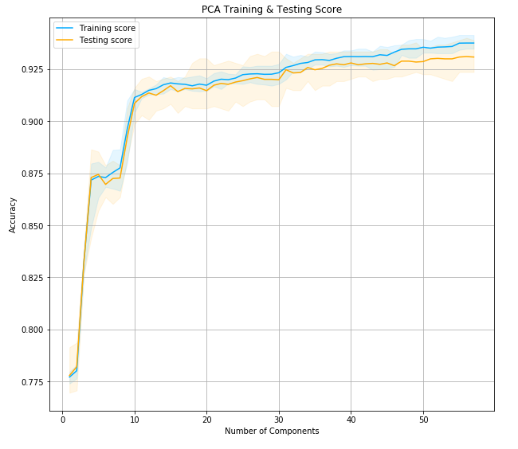
PCA
Spambase
Image Segmentation
Image Segmentation
10 komponen
Spambase
Spambase
Spambase
Data Cleaning
Normalisasi
Dataset Rebalancing
5-Fold CV
Resample
3-Fold CV
Testing
Hasil
Credit Card Fraud
Credit Card Fraud
Credit Card Fraud

Slide 23
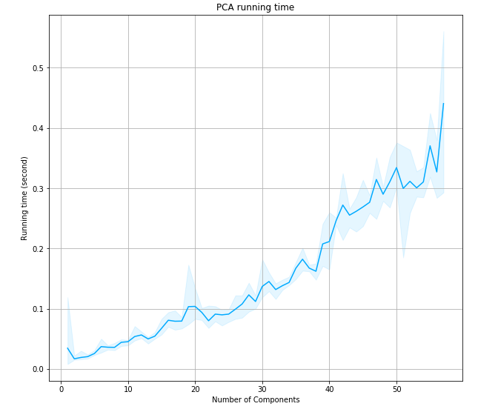
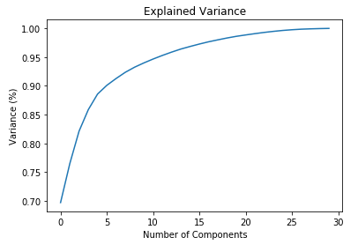
PCA
Spambase
Credit Card Fraud
Image Segmentation
Image Segmentation
Spambase
Spambase
Spambase
Data Cleaning
Normalisasi
Dataset Rebalancing
5-Fold CV
Resample
3-Fold CV
Testing
Hasil
4 komponen
Credit Card Fraud
Credit Card Fraud
Credit Card Fraud
10 komponen

Slide 24
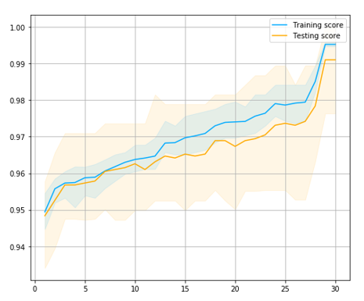
PCA
Spambase
Credit Card Fraud
Image Segmentation
Image Segmentation
Spambase
Spambase
Spambase
Data Cleaning
Normalisasi
Dataset Rebalancing
5-Fold CV
Resample
3-Fold CV
Testing
Hasil
Credit Card Fraud
2 komponen
Credit Card Fraud
Credit Card Fraud

Slide 25
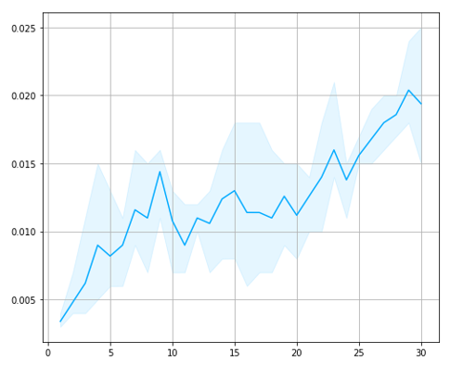
PCA
Spambase
Credit Card Fraud
Image Segmentation
Image Segmentation
Spambase
Spambase
Spambase
Data Cleaning
Normalisasi
Dataset Rebalancing
5-Fold CV
Resample
3-Fold CV
Testing
Hasil
Credit Card Fraud
Credit Card Fraud
Credit Card Fraud
2 komponen

Slide 26
PCA
Image Segmentation
Image Segmentation
Spambase
Spambase
Spambase
Data Cleaning
Normalisasi
Dataset Rebalancing
5-Fold CV
Resample
3-Fold CV
Testing
Hasil
Credit Card Fraud
Credit Card Fraud
Credit Card Fraud

Slide 27
Image Segmentation
Image Segmentation
Image Segmentation
Spambase
Spambase
Spambase
Spambase
Data Cleaning
Normalisasi
PCA
Dataset Rebalancing
5-Fold CV
Resample
3-Fold CV
Testing
Hasil
Credit Card Fraud
Credit Card Fraud
Credit Card Fraud
Credit Card Fraud

Slide 28
Dataset Rebalancing
Credit Card Fraud
Image Segmentation
Image Segmentation
Image Segmentation
Spambase
Spambase
Spambase
Data Cleaning
Normalisasi
PCA
5-Fold CV
Resample
3-Fold CV
Testing
Hasil
Credit Card Fraud
Credit Card Fraud
Credit Card Fraud

Slide 29
Dataset Rebalancing
Credit Card Fraud
Image Segmentation
Image Segmentation
Image Segmentation
560.000 observasi
Spambase
Spambase
Spambase
Data Cleaning
Normalisasi
PCA
480 kombinasi (6 teknik resampling x 80 kombinasi parameter machine learning)
5-Fold CV
Resample
3-Fold CV
Testing
Hasil
x3 cross validation (parameter)
Credit Card Fraud
Credit Card Fraud
Credit Card Fraud
x5 cross validation fitting
= 7200 kali fitting
1 kombinasi: > 4 jam

Slide 30
Dataset Rebalancing
Credit Card Fraud
Image Segmentation
Image Segmentation
Image Segmentation
Spambase
Spambase
Spambase
Data Cleaning
Normalisasi
PCA
5-Fold CV
Resample
3-Fold CV
Testing
Hasil
Credit Card Fraud
Credit Card Fraud
Credit Card Fraud

Slide 31
Dataset Rebalancing
Credit Card Fraud
Image Segmentation
Image Segmentation
Image Segmentation
Spambase
Spambase
Spambase
Data Cleaning
Normalisasi
PCA
5-Fold CV
Resample
3-Fold CV
Testing
Hasil
Credit Card Fraud
Credit Card Fraud
Credit Card Fraud

Slide 32
Dataset Rebalancing
Credit Card Fraud
Image Segmentation
Image Segmentation
Image Segmentation
Dataset Baru
486 minoritas + 1450 mayoritas
Spambase
Spambase
Spambase
Data Cleaning
Normalisasi
PCA
5-Fold CV
Resample
3-Fold CV
Testing
Hasil
200 Dataset Baru
Credit Card Fraud
Credit Card Fraud
Credit Card Fraud

Slide 33
Dataset Rebalancing
Credit Card Fraud
Image Segmentation
Image Segmentation
Image Segmentation
Dataset Baru
Resampling
Spambase
Spambase
Spambase
Data Cleaning
Normalisasi
PCA
5-Fold CV
Resample
3-Fold CV
Testing
Hasil
Balanced Dataset Baru
Credit Card Fraud
Credit Card Fraud
Credit Card Fraud
Fitting
Hasil

Slide 34
Dataset Rebalancing
Credit Card Fraud
Image Segmentation
Image Segmentation
Image Segmentation
Spambase
Spambase
Spambase
Data Cleaning
Normalisasi
PCA
5-Fold CV
Resample
3-Fold CV
Testing
Hasil
1 kombinasi: > 4 jam
200
Hasil
480 kombinasi: 1 jam 40 menit
Credit Card Fraud
Credit Card Fraud
Credit Card Fraud

Slide 35
Image Segmentation
Image Segmentation
Image Segmentation
Spambase
Spambase
Spambase
Spambase
Data Cleaning
Normalisasi
PCA
Dataset Rebalancing
5-Fold CV
Resample
3-Fold CV
Testing
Hasil
Credit Card Fraud
Credit Card Fraud
Credit Card Fraud
Credit Card Fraud
Credit Card Fraud

Slide 36
Image Segmentation
Image Segmentation
Image Segmentation
Image Segmentation
Spambase
Spambase
Spambase
Spambase
Spambase
Data Cleaning
Normalisasi
PCA
Dataset Rebalancing
5-Fold CV
Resample
3-Fold CV
Testing
Hasil
Credit Card Fraud
Credit Card Fraud
Credit Card Fraud
Credit Card Fraud
Credit Card Fraud
Credit Card Fraud

Slide 37
5-Fold CV
Image Segmentation
Image Segmentation
Image Segmentation
5-Fold CV
80% Training
Spambase
Spambase
Spambase
Spambase
Image Segmentation
Spambase
Data Cleaning
Normalisasi
PCA
Dataset Rebalancing
Resample
3-Fold CV
Testing
Hasil
20% Testing
Credit Card Fraud
Credit Card Fraud
Credit Card Fraud
Credit Card Fraud
Credit Card Fraud
Credit Card Fraud

Slide 38
5-Fold CV
Image Segmentation
Image Segmentation
Image Segmentation
5-Fold CV
Balanced Training 1
Balanced Training 2
Resampling
Balanced Training 3
80% Training
Balanced Training 4
6 teknik
Balanced Training 5
Spambase
Spambase
Spambase
Spambase
Spambase
Data Cleaning
Normalisasi
PCA
Dataset Rebalancing
Balanced Training 6
Resample
3-Fold CV
Testing
Hasil
20% Testing
Credit Card Fraud
Credit Card Fraud
Credit Card Fraud
Credit Card Fraud
Credit Card Fraud
Credit Card Fraud

Slide 39
Balanced Training 2
Balanced Training 3
Balanced Training
Balanced Training 4
Balanced Training 5
Balanced Training 6
5-Fold CV
Image Segmentation
Image Segmentation
Image Segmentation
5-Fold CV
Model SVM
Resampling
fitting
Model LR
80% Training
Balanced Training 1
Model MLP
6 teknik
Model KNN
Spambase
Spambase
Spambase
Spambase
5 algoritma ML
Model DT
Spambase
Data Cleaning
Normalisasi
PCA
Dataset Rebalancing
Resample
3-Fold CV
Testing
Hasil
20% Testing
Credit Card Fraud
Credit Card Fraud
Credit Card Fraud
Credit Card Fraud
Credit Card Fraud
Credit Card Fraud

Slide 40
Balanced Training
Balanced Training
Balanced Training
Balanced Training
Balanced Training
5-Fold CV
Image Segmentation
Image Segmentation
Image Segmentation
5-Fold CV
3-Fold CV
Resampling
fitting
80% Training
Balanced Training 1
Kombinasi Parameter
6 teknik
Spambase
Spambase
Spambase
Spambase
5 algoritma ML
Spambase
Data Cleaning
Normalisasi
PCA
Dataset Rebalancing
Resample
3-Fold CV
Testing
Hasil
Model SVM
20% Testing
Model LR
Credit Card Fraud
Credit Card Fraud
Credit Card Fraud
Credit Card Fraud
Credit Card Fraud
Credit Card Fraud
Model MLP
Model KNN
Model DT

Slide 41
Balanced Training
Balanced Training
Balanced Training
Balanced Training
Balanced Training
5-Fold CV
Image Segmentation
Image Segmentation
Image Segmentation
5-Fold CV
3-Fold CV
Resampling
Kombinasi Parameter
80% Training
6 teknik
SVM
C: 1
Kernel: RBF
Regularization: Ridge
Recall
Spambase
Spambase
Spambase
Spambase
67% Training
Spambase
Data Cleaning
Normalisasi
PCA
Dataset Rebalancing
fitting
MLP
Model
Resample
3-Fold CV
Testing
Hasil
Balanced Training 1
KNN
Recall
Avg Recall
5 algoritma ML
LR
DT
33% Testing
Uji
Recall
20% Testing
Credit Card Fraud
Credit Card Fraud
Credit Card Fraud
Credit Card Fraud
Credit Card Fraud
Credit Card Fraud
Model SVM
Model LR
Model MLP
Model KNN
Model DT

Slide 42
Balanced Training
Balanced Training
Balanced Training
Balanced Training
Balanced Training
5-Fold CV
Image Segmentation
Image Segmentation
Image Segmentation
5-Fold CV
3-Fold CV
Resampling
Kombinasi Parameter
80% Training
Balanced Training
6 teknik
SVM
C: 0.1
Kernel: Linear
Regularization: Ridge
Recall
Spambase
Spambase
Spambase
Spambase
67% Training
Spambase
Data Cleaning
Normalisasi
PCA
Dataset Rebalancing
fitting
MLP
Model
Resample
3-Fold CV
Testing
Hasil
Balanced Training 1
KNN
Recall
Avg Recall
5 algoritma ML
LR
DT
33% Testing
Uji
Recall
20% Testing
Credit Card Fraud
Credit Card Fraud
Credit Card Fraud
Credit Card Fraud
Credit Card Fraud
Credit Card Fraud
Model SVM
Model LR
Model MLP
Model KNN
Model DT

Slide 43
Balanced Training
Balanced Training
Balanced Training
Balanced Training
Balanced Training
5-Fold CV
Image Segmentation
Image Segmentation
Image Segmentation
5-Fold CV
3-Fold CV
Resampling
Kombinasi Parameter
80% Training
Balanced Training
6 teknik
SVM
C: 100
Kernel: RBF
Regularization: Ridge
Recall
Spambase
Spambase
Spambase
Spambase
67% Training
Spambase
Data Cleaning
Normalisasi
PCA
Dataset Rebalancing
fitting
MLP
Model
Resample
3-Fold CV
Testing
Hasil
Balanced Training 1
KNN
Recall
Avg Recall
5 algoritma ML
LR
DT
33% Testing
Uji
Recall
20% Testing
Credit Card Fraud
Credit Card Fraud
Credit Card Fraud
Credit Card Fraud
Credit Card Fraud
Credit Card Fraud
Model SVM
Model LR
Model MLP
Model KNN
Model DT

Slide 44
Balanced Training
Balanced Training
Balanced Training
Balanced Training
Balanced Training
5-Fold CV
Image Segmentation
Image Segmentation
Image Segmentation
5-Fold CV
3-Fold CV
Resampling
Kombinasi Parameter
80% Training
Balanced Training
6 teknik
SVM
C: 100
Kernel: RBF
Regularization: Ridge
Recall
Spambase
Spambase
Spambase
Spambase
67% Training
Spambase
Data Cleaning
Normalisasi
PCA
Dataset Rebalancing
fitting
MLP
Model
Resample
3-Fold CV
Testing
Hasil
Balanced Training 1
KNN
Recall
Avg Recall
5 algoritma ML
LR
DT
33% Testing
Uji
Recall
20% Testing
Credit Card Fraud
Credit Card Fraud
Credit Card Fraud
Credit Card Fraud
Credit Card Fraud
Credit Card Fraud
Model SVM
Model LR
Model MLP
Model KNN
Model DT

Slide 45
Balanced Training
Balanced Training
Balanced Training
Balanced Training
Balanced Training
5-Fold CV
Image Segmentation
Image Segmentation
Image Segmentation
5-Fold CV
3-Fold CV
Model SVM
Resampling
fitting
Model LR
80% Training
Balanced Training 1
Kombinasi Parameter
Model MLP
6 teknik
Model KNN
Spambase
Spambase
Spambase
Spambase
5 algoritma ML
Spambase
Data Cleaning
Normalisasi
PCA
Dataset Rebalancing
Model DT
Resample
3-Fold CV
Testing
Hasil
20% Testing
Uji
Credit Card Fraud
Credit Card Fraud
Credit Card Fraud
Credit Card Fraud
Credit Card Fraud
Credit Card Fraud
Accuracy Recall Precision F1

Slide 46
Image Segmentation
Image Segmentation
Image Segmentation
Image Segmentation
Balanced Image Segmentation
Spambase
Spambase
Spambase
Spambase
Spambase
Balanced Spambase
Data Cleaning
Normalisasi
PCA
Dataset Rebalancing
5-Fold CV
Resample
3-Fold CV
Testing
Hasil
Credit Card Fraud
Credit Card Fraud
Credit Card Fraud
Credit Card Fraud
Credit Card Fraud
Credit Card Fraud
Balanced Credit Card Fraud

Slide 47
Image Segmentation
Image Segmentation
Image Segmentation
Image Segmentation
Balanced Image Segmentation
Spambase
Spambase
Spambase
Spambase
Spambase
Balanced Spambase
Model Machine Learning
Data Cleaning
Normalisasi
PCA
Dataset Rebalancing
5-Fold CV
Resample
3-Fold CV
Testing
Hasil Akhir
Credit Card Fraud
Credit Card Fraud
Credit Card Fraud
Credit Card Fraud
Credit Card Fraud
Credit Card Fraud
Balanced Credit Card Fraud

Slide 48
Image Segmentation
Image Segmentation
Image Segmentation
Image Segmentation
Balanced Image Segmentation
Spambase
Spambase
Spambase
Spambase
Spambase
Balanced Spambase
Model Machine Learning
Hasil
Data Cleaning
Normalisasi
PCA
Dataset Rebalancing
5-Fold CV
Resample
3-Fold CV
Testing
Hasil Akhir
Credit Card Fraud
Credit Card Fraud
Credit Card Fraud
Credit Card Fraud
Credit Card Fraud
Credit Card Fraud
Balanced Credit Card Fraud

Slide 49
Image Segmentation
Image Segmentation
Image Segmentation
Image Segmentation
Balanced Image Segmentation
Spambase
Spambase
Spambase
Spambase
Spambase
Balanced Spambase
Model Machine Learning
Hasil
Data Cleaning
Normalisasi
PCA
Dataset Rebalancing
5-Fold CV
Resample
3-Fold CV
Testing
Hasil Akhir
Credit Card Fraud
Credit Card Fraud
Credit Card Fraud
Credit Card Fraud
Credit Card Fraud
Credit Card Fraud
Balanced Credit Card Fraud

Slide 50
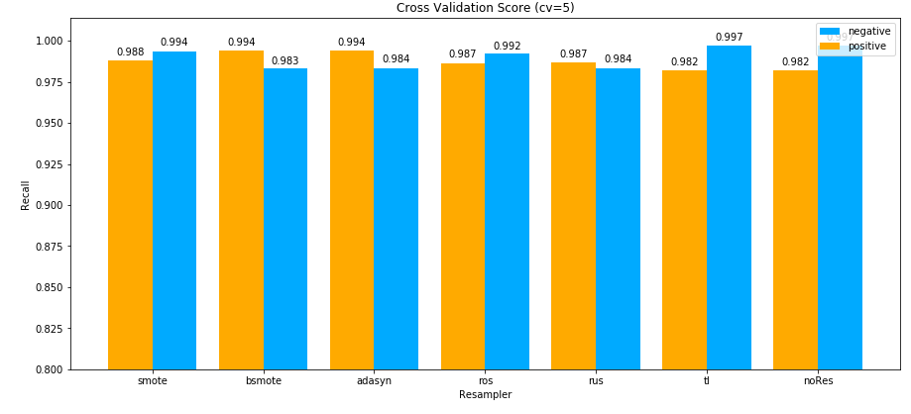
segmentation
HASIL
Segmentation Dataset
Imbalanced Ratio
1 : 6
Attributes
17
Observations
2308
ADASYN dan BSMOTE

Slide 51
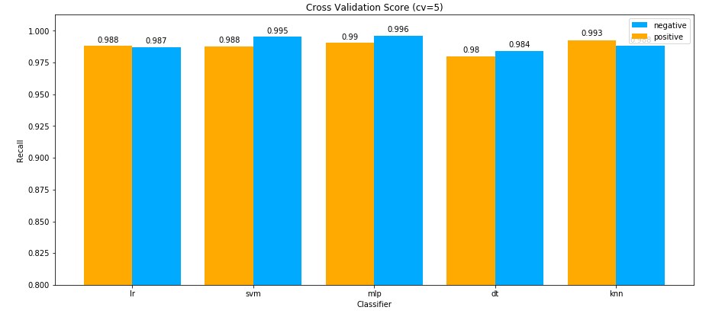
segmentation
HASIL
Segmentation Dataset
Imbalanced Ratio
1 : 6
Attributes
17
Observations
2308

Slide 52
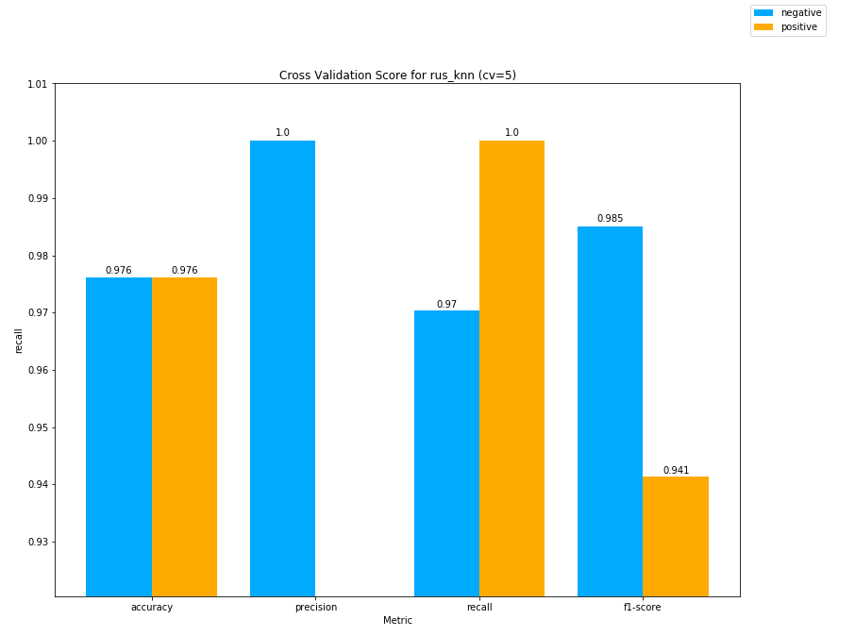

segmentation
HASIL

Slide 53
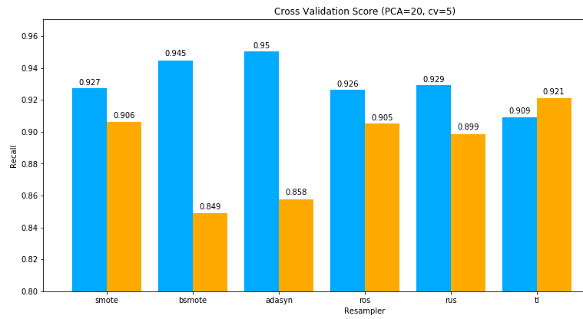

spambase
HASIL
ADASYN dan BSMOTE

Slide 54
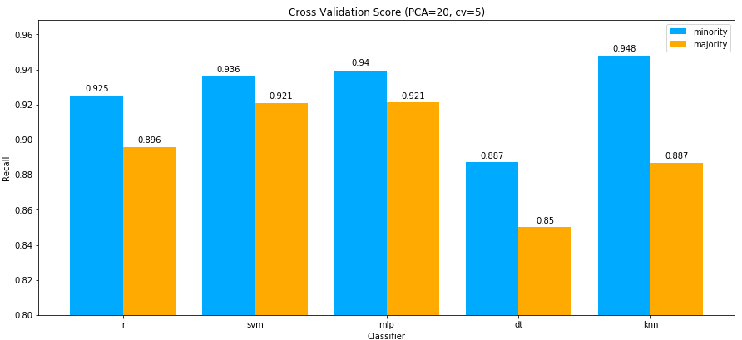
spambase
HASIL

Slide 55
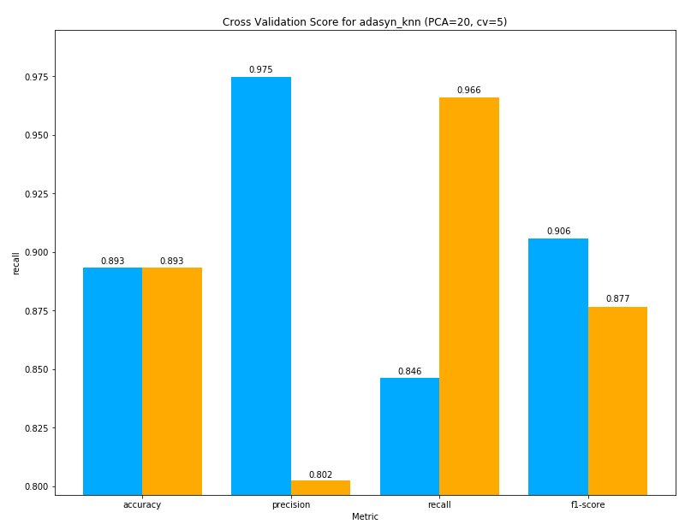
spambase
HASIL

Slide 56
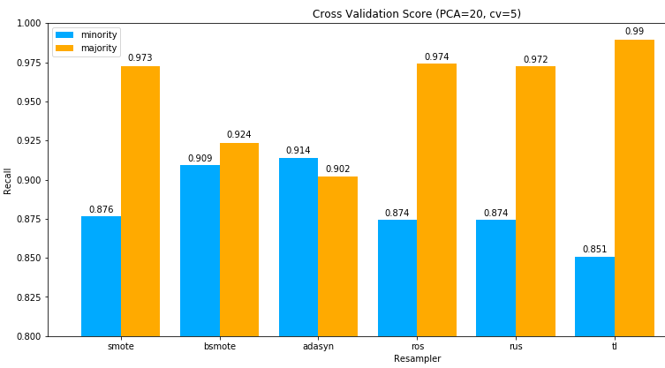
credit card
HASIL
ADASYN dan BSMOTE

Slide 57
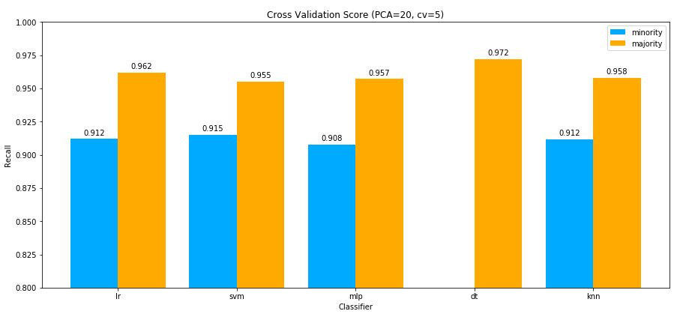
credit card
HASIL

Slide 58
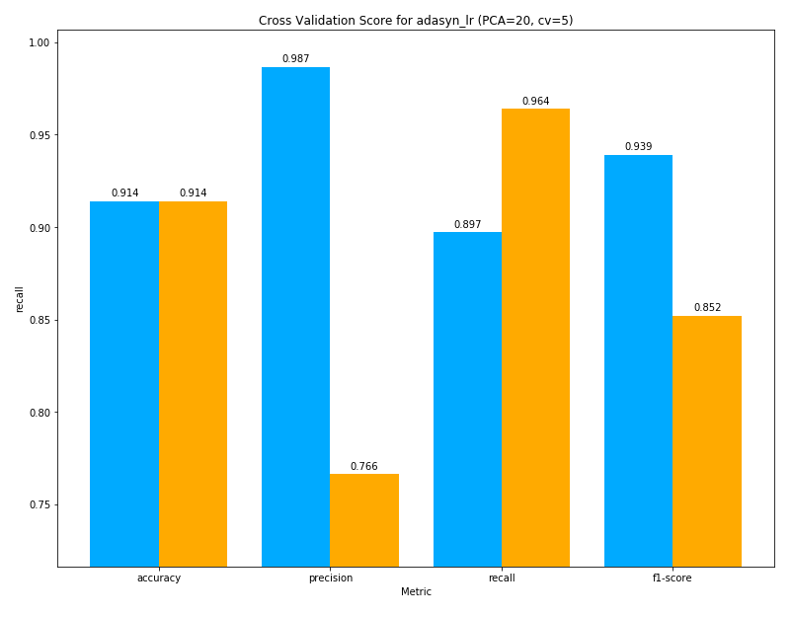
credit card
HASIL

Slide 59
KESIMPULAN
ADASYN dan BSMOTE
MLP SVM
adasyn_mlp recall, smote_knn f1, tl_mlp acc

Slide 60
Documents and Code:
http://github.com/zkgz/skripsi

Slide 61


Uniform KNN
$$x_{2}$$
k = 3
= 0
= 3
=
pred
$$x_{1}$$

Slide 62
Weighted KNN 1
$$x_{2}$$
k = 5
=
=
$$x_{1}$$

Slide 63
Weighted KNN 1
$$x_{2}$$
k = 5
=
2
=
3
$$x_{1}$$

Slide 64
Weighted KNN 1
$$x_{2}$$
k = 5
=
=
=
pred
$$x_{1}$$

Slide 65


Weighted KNN 2
$$x_{2}$$
k = 3
=
$$\frac{1}{6}$$
=
$$\frac{2}{14}$$
=
pred
$$x_{1}$$

